Slide 1
Software Architecture Introduction
UNIT 1

Slide 2

Reference
sites.google.com/view/snandagopalan

Slide 3
Agenda
The Architecture Business Cycle: Where do architectures come from?
Software processes and the architecture business cycle
What makes a “good” architecture?
What software architecture is and what it is not Other points of view
Architectural patterns, reference models and reference architectures
Importance of software architecture; Architectural structures and views.

Slide 4
Introduction to SA
Software application architecture is the process of defining a structured solution that meets all of the technical and operational requirements, while optimizing common quality attributes such as performance, security, and manageability.
It involves a series of decisions
impact on the quality, performance, maintainability, and overall success of the application.

Slide 5
Contd.
For decades, software designers have been taught to build systems based exclusively on the technical requirements.
Software Architecture encompasses the structures of large software systems:
abstract view.
eliminates details of implementation, algorithm, & data representation.
concentrates on the behavior & interaction of “black box” elements.

Slide 6
Defn.
The software architecture of a program or computing system is the structure or structures of the system, which comprise software elements, the externally visible properties of those elements, and the relationships among them.

Slide 7
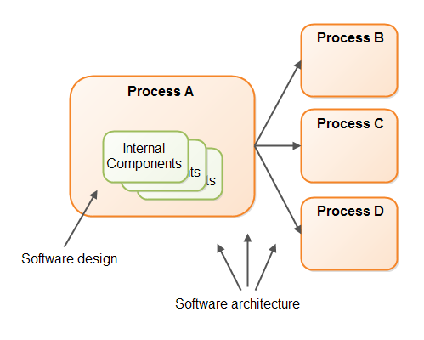
In a Nutshell
Software design is concerned with the internal design of a single software process. SA is concerned with the design of how multiple software processes cooperate to carry out their tasks.

Slide 8
The role of a Software Architect
Interact with clients, product managers, and developers in order to envision, model and provide initial models and designs that can be built.
Constantly review the code to ensure the quality of the design by avoiding complexity, advocating clarity and to do this with the team. Develop prototypes…
Collaborative working with a degree of humility and providing mentoring as required. Teams and specific works assigned.
An architect should have knowledge in programming, management, psychology, communication and even finance.

Slide 9
Contd.

Slide 10
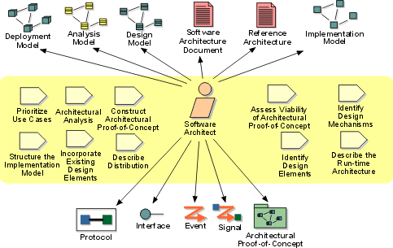
Contd.

Slide 11
Characteristics of a Software Architect
Broad and deep technical knowledge – several technologies
Responsibility – decision making
Communicability. A good specialist should be able to talk with customers in the language of business, managers of all levels, business analysts and developers in their languages.
Management skills. This includes both organizational and leadership skills.
Stress resistance.
Analytic skills.

Slide 12
Responsibilities of a Software Architect
Identifying business requirements and requirements of the stakeholders on the project
Designing the entire system based on the received requirements
Choosing the system architecture and each individual component of this system at a high level
Choosing the technologies for the implementation of each component and connections between the components
Architectural review
Code-review
Writing project documentation and its support
Creating unified development standards in the company
Controlling the architecture during the next iteration of the system release

Slide 13
Why is Architecture Important?
Like any other complex structure, software must be built on a solid foundation. Failing to consider key scenarios, failing to design for common problems, or failing to appreciate the long term consequences of key decisions can put your application at risk.
Modern tools and platforms help to simplify the task of building applications, but they do not replace the need to design your application carefully, based on your specific scenarios and requirements.
The risks exposed by poor architecture include software that is unstable, is unable to support existing or future business requirements, or is difficult to deploy or manage in a production environment.

Slide 14
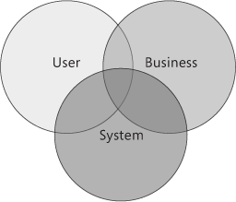
Contd.
Systems should be designed with consideration for the user, the system (the IT infrastructure), and the business goals.
For each of these areas, you should outline key scenarios and identify important quality attributes (for example, reliability or scalability) and key areas of satisfaction and dissatisfaction.
Where possible, develop and consider metrics that measure success in each of these areas.

Slide 15
Architecture Vs. Design
Architecture focuses on how the major elements and components within an application are used by, or interact with, other major elements and components within the application.
The selection of data structures and algorithms or the implementation details of individual components are design concerns.
Architecture and design concerns very often overlap. Rather than use hard and fast rules to distinguish between architecture and design, it makes sense to combine these two areas.
In some cases, decisions are clearly more architectural in nature. In other cases, the decisions are more about design, and how they help you to realize that architecture.

Slide 16
Architecture Business Cycle (ABC)
What is the relationship of a system’s software architecture to the environment in which the system will be constructed and exist?
Software architecture is a result of technical, business, and social influences.
These influences and feedback loops form the Architecture Business Cycle (ABC).
In turn, it affects each of these environments

Slide 17
High level concerns
How will the users be using the application?
How will the application be deployed into production and managed?
What are the quality attribute requirements for the application, such as security, performance, concurrency, internationalization, and configuration?
How can the application be designed to be flexible and maintainable over time?
What are the architectural trends that might impact your application now or after it has been deployed?

Slide 18
Where do Architectures Come From?
The result of a set of business and technical decisions.
In any development effort, the requirements make explicit some - but only some - of the desired properties of the final system.
Failure to satisfy non-documented constraints can cause as many problems as if it functioned poorly.

Slide 19
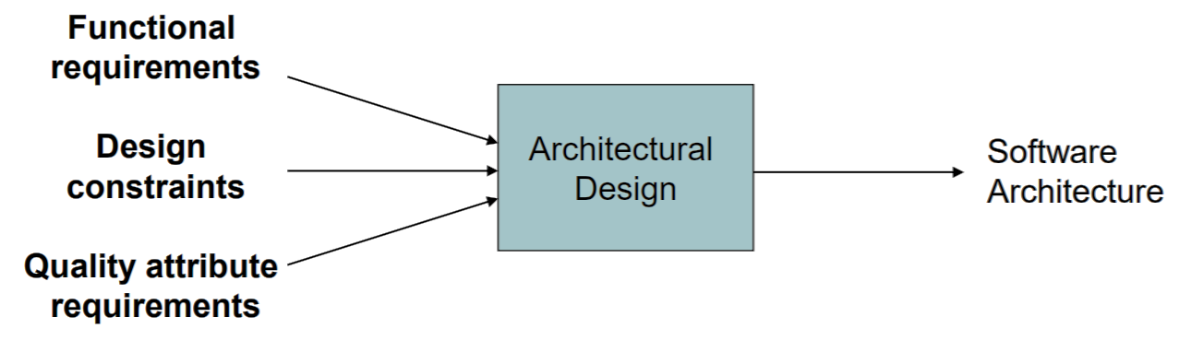
Contd.
Keep in mind that the architecture should:
Expose the structure of the system but hide the implementation details.
Realize all of the use cases and scenarios.
Try to address the requirements of various stakeholders.
Handle functional, design and quality requirements.

Slide 20
Contd.
Stakeholders
each stakeholder has different concerns & goals, some contradictory
Development Organization
immediate business, long-term business, and organizational (staff skills, schedule, & budget)
Background & Experience of the Architects
repeat good results, avoid duplicating disasters
The Technical Environment
standard industry practices or common SE techniques

Slide 21
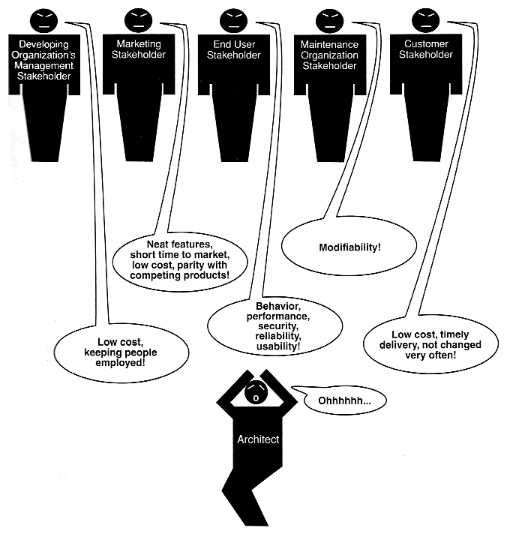
1. System Stakeholders
Example: The customer, the end users, the developers, the project manager, the maintainers, and even those who market the system

Slide 22
2. Development Organization
If the organization has programmers skilled in client-server communications, then a client-server architecture might be the approach supported by management. If not, reject.
Staff skills are one additional influence, but development schedule and budget are also important.
Immediate business - immediate business investment in certain assets
Long-term business - infrastructure to pursue strategic goals and may view the proposed system as one means of financing and extending that infrastructure.
Organizational structure - the development of some of the subsystems was subcontracted (they are expertized)

Slide 23
3. Background & Experience of the Architects
If the architects for a system have had good results using a particular architectural approach, chances are that they will try that same approach on a new development effort.
Otherwise they will not try!
They may try some other patterns.

Slide 24
4. The Technical Environment
object oriented,
WWW,
intelligent agents,
EJB,
service oriented,
J2EE,
thin client (?),
.NET, etc.

Slide 25
Ramifications (Subdivision) of Influences
Almost never are the properties required by the business & organizational goals consciously understood, let alone fully articulated.
Architects need to know & understand the nature, source, and priority of constraints on the project as early as possible.
Architects must identify & actively engage the stakeholders to solicit their needs & expectations.
Use architecture reviews & iterative prototyping

Slide 26
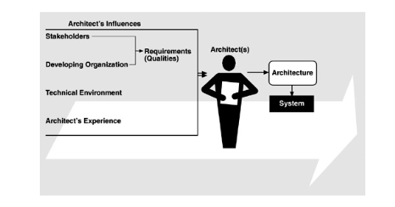
Influences on the Architect

Slide 27
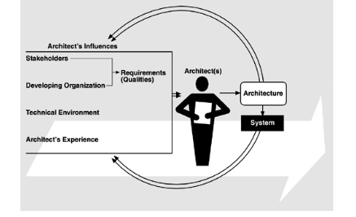
Architectures affect the factors that influence them
The relationships among business goals, product requirements, architects’ experience, architectures, and fielded systems form a cycle with feedback loops that a business can manage:
to handle growth, to expand enterprise area, and to take advantage of previous investments in architecture & system building.

Slide 28
Working of this cycle
1.
An architecture prescribes a structure for a system
It prescribes the units of software that must be implemented (or otherwise obtained) and integrated to form the system.
These units are the basis for the development project's structure.
Teams are formed for individual software units; and the development, test, and integration activities all revolve around the units.
Schedules and budgets allocation also take place.

Slide 29
Contd.
The architecture can affect the goals of the developing organization.
A successful system built from it can enable a company to establish a foothold in a particular market area.
The architecture can provide opportunities for the efficient production and deployment of similar systems.

Slide 30
Contd.
2. The architecture can affect customer requirements for the next system by giving the customer the opportunity to receive a system (based on the same architecture) in a more reliable, timely, and economical manner than if the subsequent system were to be built from scratch.
Example: a product line architecture caused customers to happily compromise their requirements because they could get high-quality software that fit their basic needs quickly, reliably, and at lower cost.

Slide 31
Contd.
3.
The process of system building will affect the architect's experience with subsequent systems by adding to the corporate experience base.
Example: .NET based systems

Slide 32
Contd.
4.
A few systems will influence and actually change the software engineering culture, That is, the technical environment in which system builders operate and learn.
Example:
RDBMS – in 1960s
Windows – in 1980s
WWW – in 1990s
J2EE – 21st Century

Slide 33
Software Processes & the ABC
What activities are involved in creating a software architecture, using that architecture to realize a design, and then implementing or managing the evolution of a target system or application?

Slide 34
Software Processes
Creating the business case for the system
Understanding the requirements
Creating or selecting the architecture
Documenting and communicating the architecture
Analyzing or evaluating the architecture
Implementing the system based on the architecture
Ensuring that the implementation conforms to the architecture

Slide 35
Activities
Creating the business case for the system
How much should the product cost?
What is its targeted market?
What is its targeted time to market?
Will it need to interface with other systems?
Are there system limitations that it must work within?
Understanding the requirements
object-oriented analysis uses scenarios, or "use cases" to embody requirements
prototypes
Creating or selecting the architecture
Achieving Qualities and Designing the Architecture show how to create an architecture to achieve its behavioral and quality requirements

Slide 36
Contd.
Documenting and communicating the architecture
behavioral and quality requirements
developers must understand the work assignments it requires of them, testers must understand the task structure it imposes on them, management must understand the scheduling implications it suggests, and so forth
Analyzing or evaluating the architecture
Choosing among competing designs in a rational way is one of the architect's greatest challenges
Implementing the system based on the architecture
Having an explicit and well-communicated architecture is the first step toward ensuring architectural conformance
Ensuring that the implementation conforms to the architecture
when an architecture is created and used, it goes into a maintenance phase

Slide 37
What makes a Good Architecture?
No such thing as an inherently good or bad architecture.
A distributed three-tier client-server architecture may be just the ticket for a large enterprise's financial management system but completely wrong for an avionics application.
Architectures are more or less fit for some stated purpose.
Architectures can be evaluated - one of the great benefits of paying attention to them - but only in the context of specific goals.
Rules of Thumb: process & product (structural) recommendations

Slide 38
Process Recommendations
Include functional requirements and a prioritized list of quality attributes the system must satisfy analyze & formally evaluate before it is too late to change.
Well documented.
Should be circulated to the system's stakeholders
Ex. Network utilization may be very important.

Slide 39
Product Recommendations
Well-defined modules whose functional responsibilities are allocated on the principles of information hiding and separation of concerns
Each module should have a well-defined interface that encapsulates or "hides" changeable aspects
Quality attributes should be achieved using well-known architectural tactics
The architecture should never depend on a particular version of a commercial product or tool
Modules that produce data should be separate from modules that consume data. Interaction pattern.

Slide 40
What is Software Architecture?

Slide 41
Product Recommendations
SA plays a pivotal role in allowing an organization to meet its business goals
SA is an asset that holds tangible value to the developing organization beyond the project for which it was created.
Control Process (CP)
underwater acoustic simulation
Is it a SA?
Prop Loss Model
(MODP)
Reverb Model
(MODR)
Noise Model (MODN)

Slide 42
What’s Missing?
What is the nature of the elements?
What are the responsibilities of the elements?
What is the significance of the connections?
What is the significance of the layout?
Unless we know precisely what the elements are & how they cooperate to accomplish the purpose of the system, this diagram is unhelpful!

Slide 43
Definition Again
The software architecture of a program or computing system is the structure or structures of the system, which comprise software elements, the externally visible properties of those elements, and the relationships between them.
We see the elements (CP, MODP, MODR, MODN), but what properties do they or their relationships have?

Slide 44
Externally Visible Properties
The assumptions that other elements can make of an element, such as:
its provided services,
performance characteristics,
fault handling,
shared resource usage,
etc.

Slide 45
Definition Implications
1 - architecture defines software elements.
2 - systems can and do comprise more than one structure, all are part of the architecture.
3 - every computing system with software has an architecture.
4 - the behavior of each element is part of the architecture as far as its behavior can be observed from the point of view of another element.
5 - the definition doesn’t judge goodness or badness.

Slide 46
More Points
The study of software architecture has evolved by observation of the design principles that designers follow and the actions that they take when working on real systems.
Architecture is high-level design
Architecture is the overall structure of the system
Architecture is the structure of the components of a program or system, their interrelationships, and the principles and guidelines governing their design and evolution over time

Slide 47
Useful Concepts
Three stages that capture characteristics of an architecture, on the way from box-and-arrow to full software architectures:
Architectural Patterns
Reference Models
Reference Architectures
Reference Model
Reference Architecture
Software Architecture
Architectural Pattern
Figure 2.2

Slide 48
Analogy
They commonly associate architecture with physical structure (buildings, streets, hardware) and physical arrangement.
A building architect must design a building that provides accessibility, aesthetics, light, maintainability, and so on.
A software architect must design a system that provides concurrency, portability, modifiability, usability, security, and the like, and that reflects consideration of the tradeoffs among these needs

Slide 49
Why Is Software Architecture Important?
Why architecture matters from a technical perspective?
Communication among stakeholders
Early design decisions – for development, deployment, and maintenance
Transferable abstraction of a system - can be applied to other systems exhibiting similar quality attribute and functional requirements

Slide 50
ARCHITECTURE IS THE VEHICLE FOR STAKEHOLDER COMMUNICATION
Each stakeholder of a software system—customer, user, project manager, coder, tester, and so on—is concerned with different system characteristics that are affected by the architecture
Architecture provides a common language in which different concerns can be expressed, negotiated, and resolved even for large, complex systems
"What Happens When I Push This Button?"

Slide 51
ARCHITECTURE MANIFESTS THE EARLIEST SET OF DESIGN DECISIONS
These early decisions are the most difficult to get correct and the hardest to change later in the development process, and they have the most far-reaching effects
The Architecture Defines Constraints on Implementation –
An implementation exhibits an architecture if it conforms to the structural design decisions described by the architecture
Resource allocation decisions also constrain implementations

Slide 52
Contd.
The Architecture Dictates Organizational Structure –
The normal method for dividing up the labor in a large system is to assign different groups different portions of the system to construct. –
This is called the work breakdown structure of a system.
Once the architecture has been agreed on, then, it becomes almost impossible, for managerial and business reasons, to modify it.
The Architecture Inhibits or Enables a System's Quality Attributes
For high performance, manage the time-based behavior of elements
For modifiability, you need to assign responsibilities to elements
For security, manage and protect inter-element communication
For scalability, localize the use of resources
For re-usability, restrict inter-element coupling

Slide 53
Contd.
Predicting System Qualities by Studying the Architecture - it is possible to make quality predictions about a system based solely on an evaluation of its architecture
The Architecture Makes It Easier to Reason about and Manage Change - roughly 80 percent of a typical software system's cost occurs after initial deployment. Software systems change over their lifetimes; they do so often and often with difficulty.
The Architecture Helps in Evolutionary Prototyping - Once an architecture has been defined, it can be analyzed and prototyped as a skeletal system

Slide 54
Contd.
The Architecture Enables More Accurate Cost and Schedule Estimates - Cost and schedule estimates are an important management tool to enable the manager to acquire the necessary resources and to understand whether a project is in trouble

Slide 55
ARCHITECTURE AS A TRANSFERABLE, RE-USABLE MODEL
The earlier in the life cycle re-use is applied, the greater the benefit that can be achieved
Software Product Lines Share a Common Architecture -
A product line is a set of products that together address a particular market segment or fulfill a particular mission. Product lines are, of course, nothing new in manufacturing. Airbus builds one, and so do Ford, Dell, and even McDonald’s.
A software product line is a set of software-intensive systems sharing a common, managed set of features that satisfy the specific needs of a particular market segment or mission and that are developed from a common set of core assets in a prescribed way

Slide 56
Contd.
Systems Can Be Built Using Large, Externally Developed Elements
Earlier software paradigms focused on programming as the prime activity, with progress measured in lines of code
Architecture-based development focuses on composing or assembling elements that are likely to have been developed separately, even independently, from each other
Replacement, interchangeability

Slide 57
Contd.
An Architecture Permits Template-Based Development
An architecture embodies design decisions about how elements interact that, while reflected in each element's implementation, can be localized and written just once

Slide 58
Architectural Structures and Views
The neurologist, the orthopedist, the hematologist, and the dermatologist all have a different view of the structure of a human body.
These views have very different properties, but all are inherently related. Together they describe the architecture of the human body.
Modern systems are more than complex enough to make it difficult to grasp them all at once.
Instead, we restrict our attention at any one moment to one (or a small number) of the software system's structures and its views.

Slide 59
Defn.
Structure: The set of elements itself, as they exist in software or hardware
View: a representation of a coherent set of architectural elements and their relationships

Slide 60
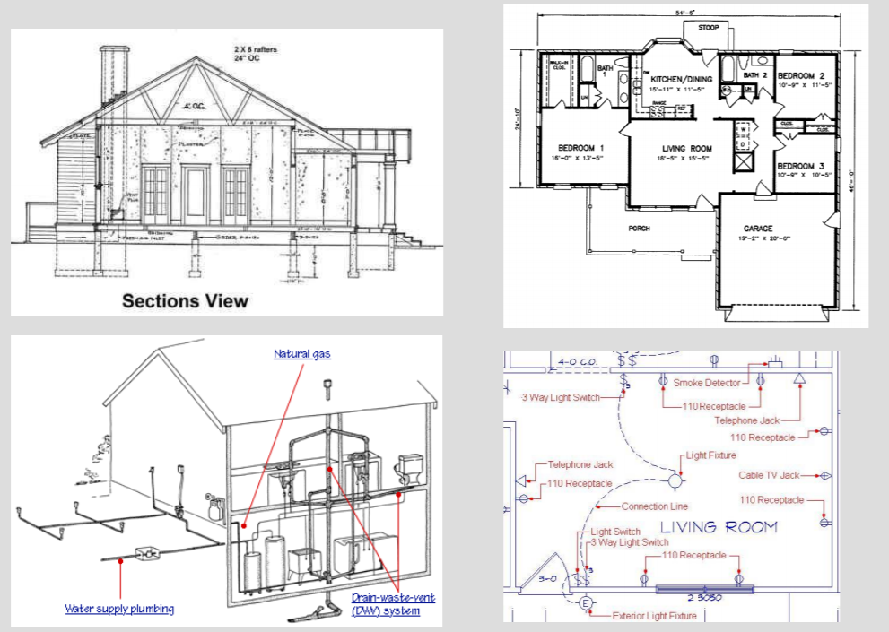
Views

Slide 61
Architectural structures
Module structures. Here the elements are modules, which are units of implementation. Modules represent a code-based way of considering the system. They are assigned areas of functional responsibility. Software, generalization, specialization, etc.
Component-and-connector structures. Here the elements are runtime components (which are the principal units of computation) and connectors (which are the communication vehicles among components). Data store, parallelism, replication, etc.
Allocation structures. Relationship between the software elements and the elements in one or more external environments in which the software is created and executed. Processor, files, software element to dev. Teams, etc.

Slide 62
Contd.

Slide 63
Architectural design decisions
How is the system to be structured as a set of code units (modules)?
How is the system to be structured as a set of elements that have runtime behavior (components) and interactions (connectors)?
How is the system to relate to nonsoftware structures in its environment (i.e., CPUs, file systems, networks, development teams, etc.)?

Slide 64
Module
Decomposition. The units are modules related to each other by the "is a submodule of " relation, showing how larger modules are decomposed into smaller ones recursively until they are small enough to be easily understood.
Uses. The uses structure is used to engineer systems that can be easily extended to add functionality or from which useful functional subsets can be easily extracted.
Layered. layer n may only use the services of layer n – 1.
Class, or generalization. The module units in this structure are called classes. The relation is "inherits-from" or "is-an-instance-of."

Slide 65
Component-and-Connector
Process: The units here are processes or threads that are connected with each other by communication, synchronization, and/or exclusion operations
Concurrency: opportunities for parallelism and the locations where resource contention may occur
Shared data, or repository. This structure comprises components and connectors that create, store, and access persistent data
Client-server.

Slide 66
Allocation
Deployment. shows how software is assigned to hardware-processing and communication elements.
Implementation. How software elements (usually modules) are mapped to the file structure(s) in the system's development, integration, or configuration control environments.
Work assignment. assigns responsibility for implementing and integrating the modules to the appropriate development teams

Slide 67
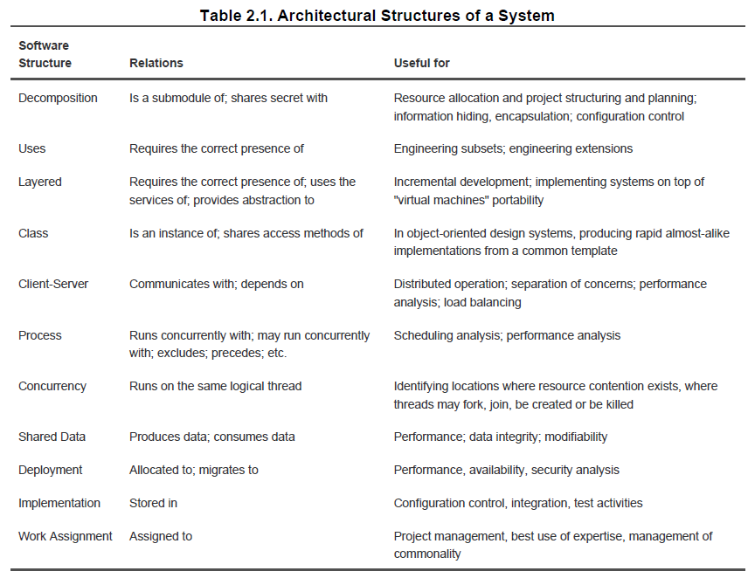

Slide 68
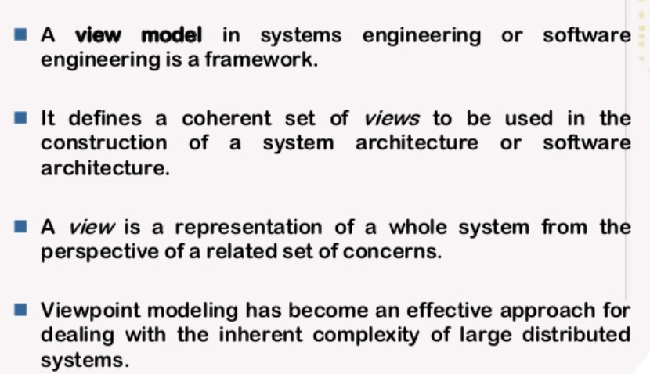
What is View Model?

Slide 69
Possible Views (Viewpoint)
Functional/logic view
Module/code view
Development/structural view
Concurrency/process/runtime/thread view
Physical/deployment/install view
User action/feedback view
Data view/data model

Slide 70
Kruchten’s 4+1 view model
Logical. The elements are "key abstractions," which are manifested in the object-oriented world as objects or object classes. Functional requirements.
This is a module view.
Process. This view addresses concurrency and distribution of functionality. It is a component-and-connector view. Non-functional requirements.
Implementation. This view shows the organization of software modules, libraries, subsystems, and units of development. It is an
allocation view, mapping software to the development environment.
Deployment/Physical. This view maps other elements onto processing and communication nodes and is also an allocation view.

Slide 71
Summary

